Slide 1

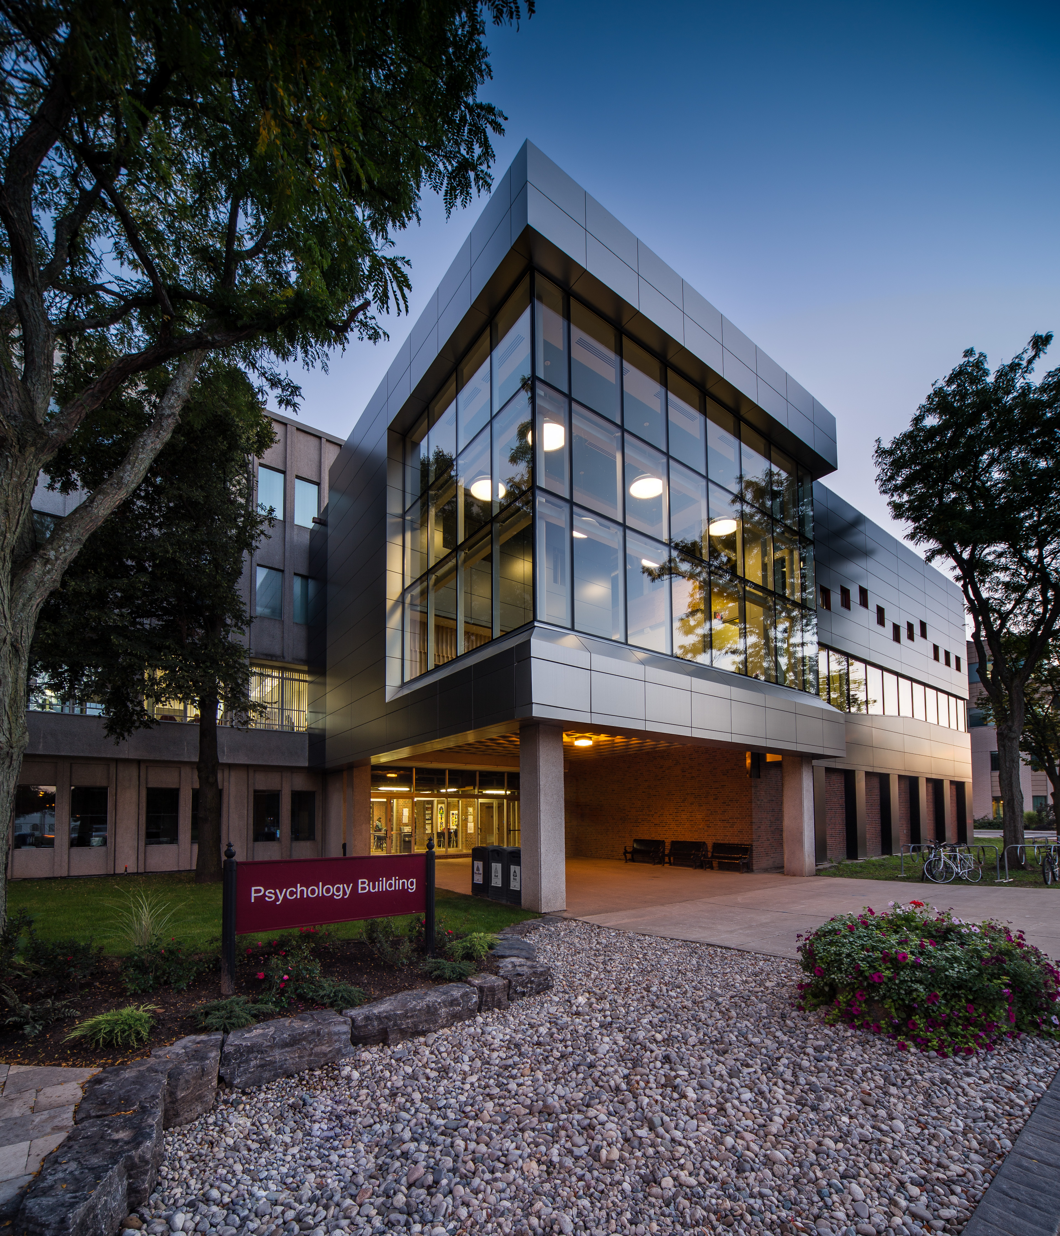

Signals, Sensors, Sounds WORKSHOP
Lauren Fink, PhD
Asst. Professor, McMaster University
Dept. of Psychology, Neuroscience & Behaviour
McMaster Institute for Music & the Mind / LIVELab
School of Computational Science & Engineering
Center for Advanced Research in Experimental & Applied Linguistics (ARiEAL)
Neuroscience
LIVELab
2024

Slide 2
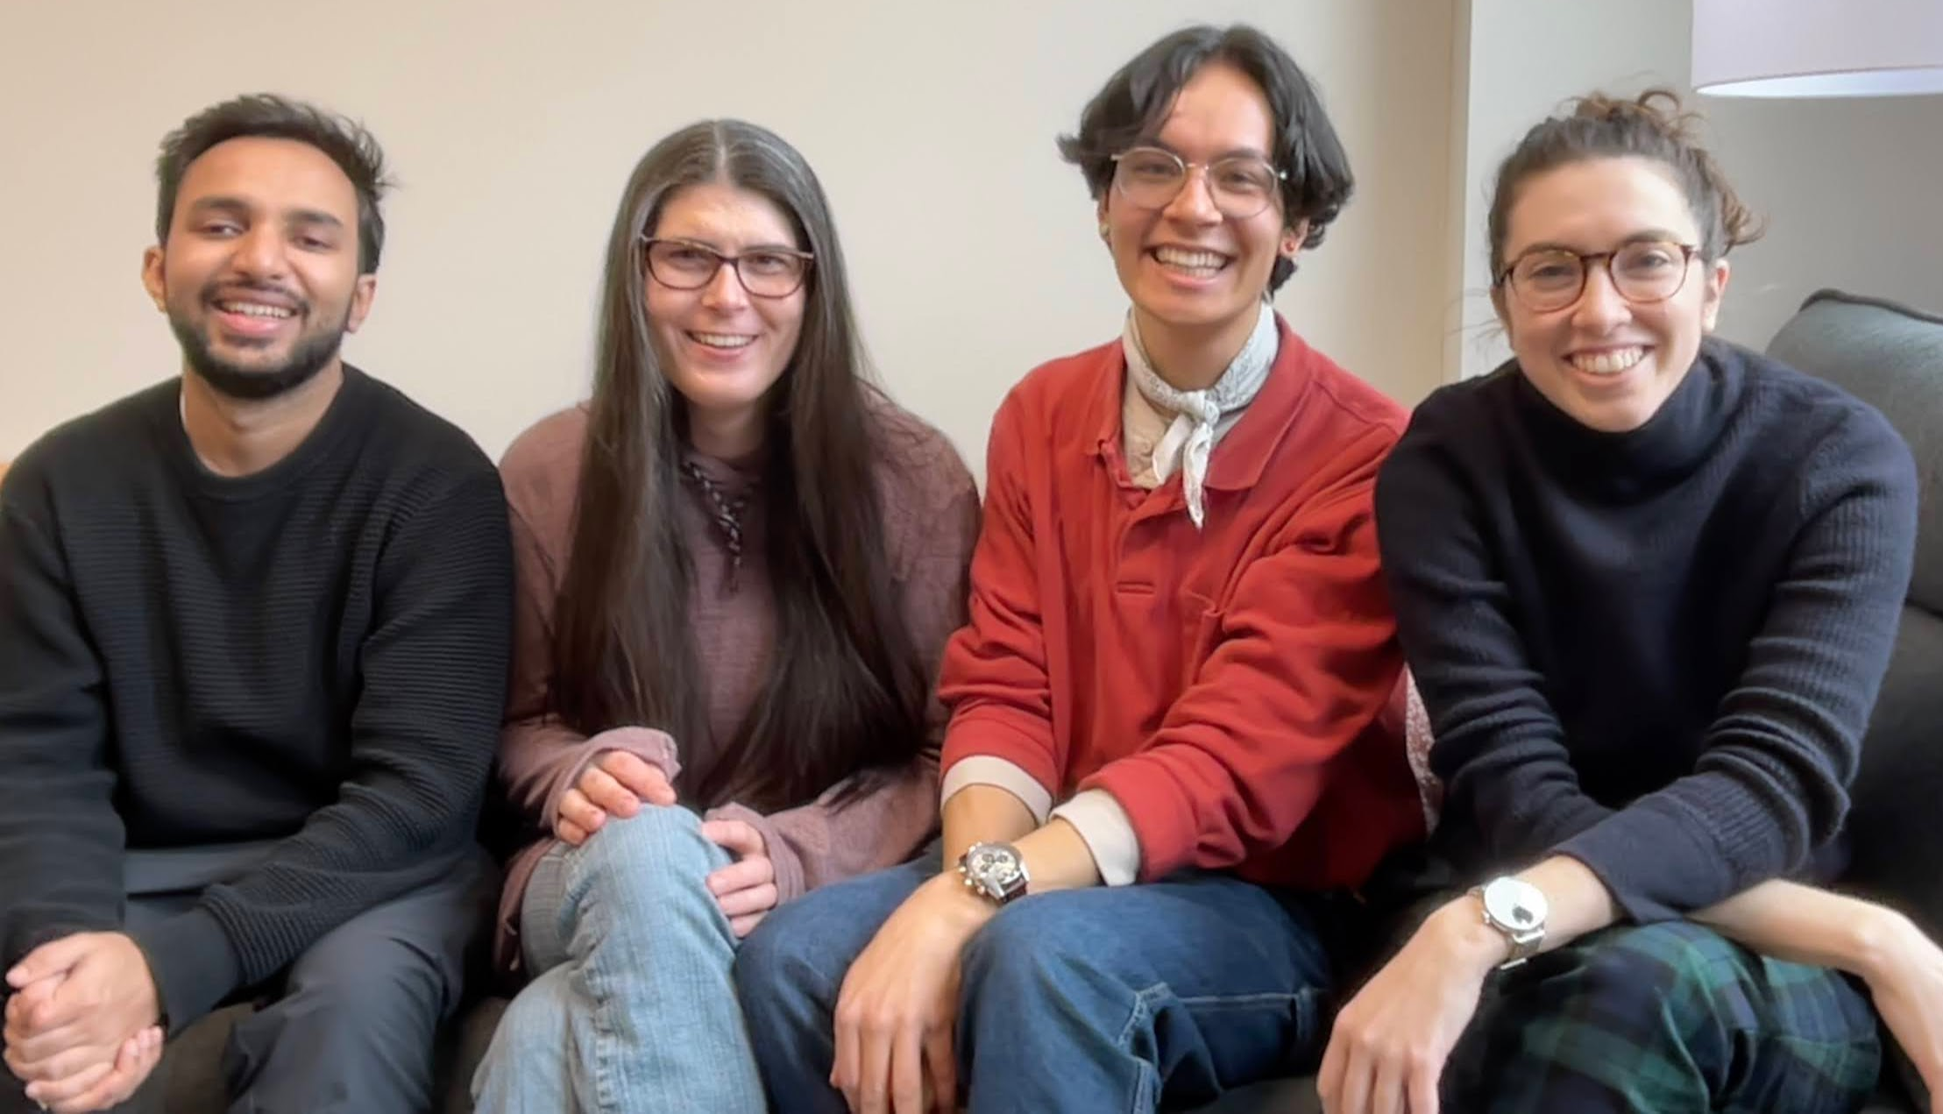
Your instructors for today
Shreshth
Saxena
Maya
Flannery
Joshua
Schlichting
Lauren
Fink

Slide 3
Overview
What are signals, sensors, & sounds?
Signals
Sensors
Sounds
Music?
Why should we care about signals, sensors, and sounds?
Understanding psychological and physiological responses to music
Creating more immersive music
Practical skills
Working with musical signals
Cardiac signals
Eye-tracking signals
Notes:
name of workshop -- what are all of these words?

Slide 4
What is a signal?
Signal refers to both the process and the result of transmission of data over some media, accomplished by embedding some variation.
Signals often convey information
Signaling occurs in all organisms, even at cellular levels
Examples:
Speech
Video
Action potential of a neuron

Slide 5



What is a sensor?
A device which detects or measures a physical property and records, indicates, or otherwise responds to it. Often a sensor detects one type of signal and outputs another type of signal!
Can you think of some examples of a sensor?
What might the limitations of a sensor be?
Notes:
Sensors measure something physical .. But does the physical world include everything we care about?
(psychology)
Sampling rate, noise, quality

Slide 6
What is sound?
Sound is a vibration that propagates as an acoustic wave through a transmission medium such as a gas, liquid or solid.

Slide 7
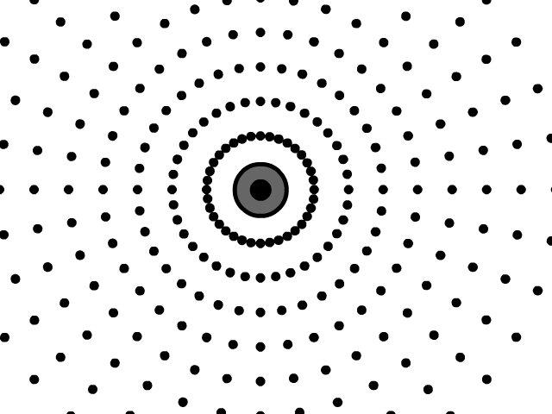
What is sound?
Sound is a vibration that propagates as an acoustic wave through a transmission medium such as a gas, liquid or solid.
https://stickmanphysics.com/wp-content/uploads/2020/03/Longitudinal-Wave-Sound-Wave-2.gif

Slide 8
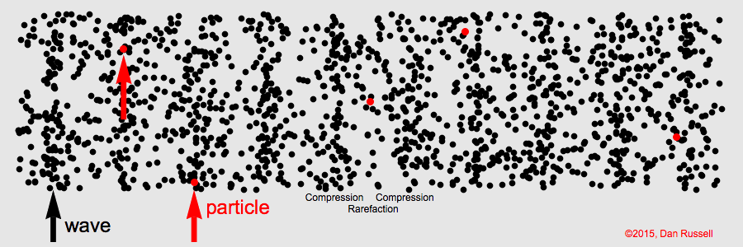
Notes:
compression and rarefaction
amplitude

Slide 9
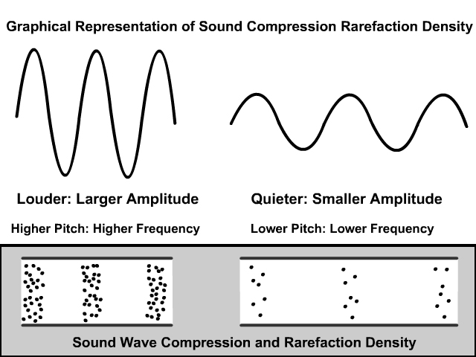
What is sound?
https://stickmanphysics.com/stickman-physics-home/unit-10-waves/sound-waves/

Slide 10
What is sound?
https://pudding.cool/2018/02/waveforms/

Slide 11

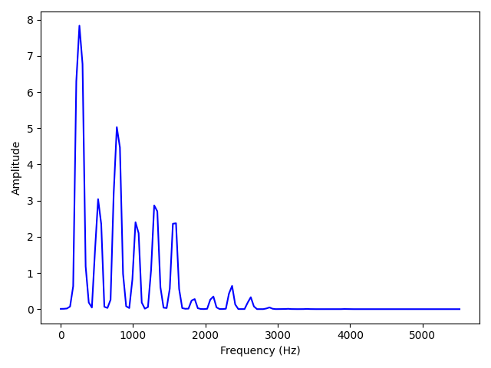
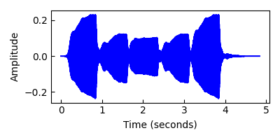
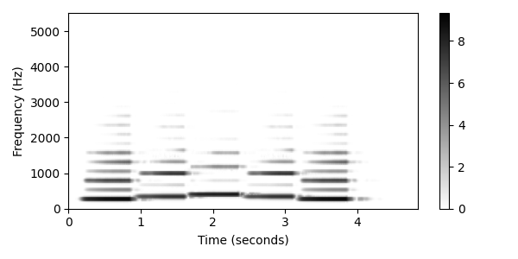
Many different ways to represent sound
Spectrum (1st note)
Waveform
Spectrogram
Credit: Tuomas Eerola
Notes:
Amplitude envelope
Can also get into

Slide 12
Many different ways to represent sound
https://musiclab.chromeexperiments.com/Spectrogram/
Notes:
Sensors measure something physical .. But does the physical world include everything we care about?
(psychology)
Sampling rate, noise, quality

Slide 13
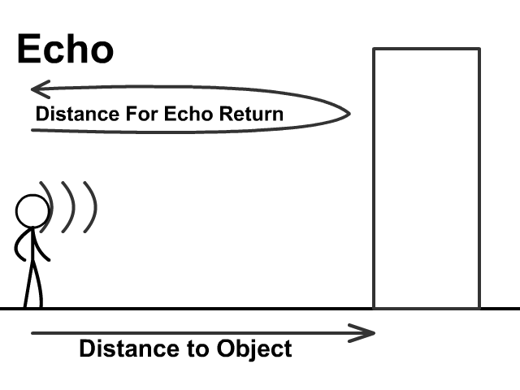
https://stickmanphysics.com/wp-content/uploads/2020/03/Sound-Echo.gif
Notes:
Sensors measure something physical .. But does the physical world include everything we care about?
(psychology)
Sampling rate, noise, quality

Slide 14
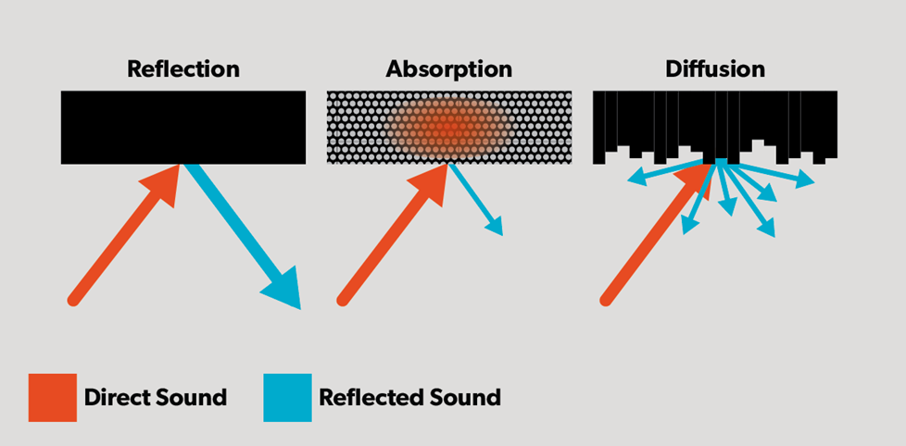
https://www.crutchfield.ca/S-HKoUfUFroVq/learn/room-acoustics-home-audio.html
Notes:
Direct sound
The sound that travels directly from the source to the listener's ears, without any reflections. It carries the most information and is the sound we want to hear.
Sound reflection
When sound waves hit a surface and bounce back towards the listener. Reflections can cause issues like echoes, standing waves, and interference with the clarity of sound.
Sound absorption
The process of reducing the amount of sound energy that is reflected back into a room. Absorption works best with high- and midrange frequencies.
Here are some things to consider about sound absorption, reflection, and direct sound:
Loudness
The loudness of reflected sound is always less than direct sound because it travels further and loses some energy at each reflection. However, the combination of direct and reflected sound can result in loudness that is greater than direct sound alone.
Early reflections
Early reflections are those that arrive at the ear within the first 60 ms. They can improve the loudness of the perceived sound, and are essential for achieving adequate speech intelligibility in situations where the direct sound is reduced.
Destructive interference
When direct and reflected sounds merge at the listener's ear, the phase of the delayed sound can be the exact opposite of the direct sound. This can cause the sounds to cancel each other out, which is known as destructive interference.
Treatment
To treat reflection points, you can use absorptive acoustic panels, broadband absorption, or a combination of absorption and diffusion.

Slide 15
LIVELab acoustics DEMO!!
What type of room do you think would be best for a music recording?
What about a performance?
Notes:
Reverb can have strong effect on listeners

Slide 16
But what is music…?
Oxford:
vocal or instrumental sounds (or both) combined in such a way as to produce beauty of form, harmony, and expression of emotion.
the written or printed signs representing vocal or instrumental sound.
Definition often incorporates cultural and psychological factors, making it subjective

Slide 17
What biological sensors are involved in our processing of music?
Does a signal recorded from a microphone represent what humans will perceive?

Slide 18
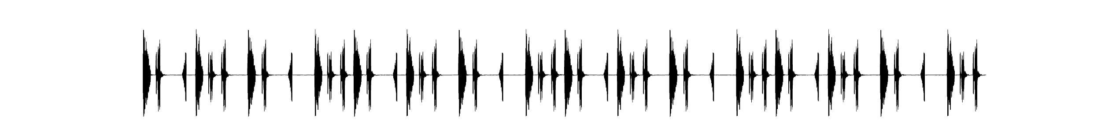
Clap along to the beat
Rhythm (acoustic): the pattern of timing and stress in the amplitude envelope of an acoustic sequence
Beat (psychological): most salient temporal periodicity
Meter (psychological): grouping(s) of perceived salient periodicities

Slide 19
Music != Sound
Amplitude (acoustic) != Loudness (psychological)
Frequency (acoustic) != Pitch (psychological)
https://www.youtube.com/watch?v=LVWTQcZbLgY&ab_channel=Vox

Slide 20
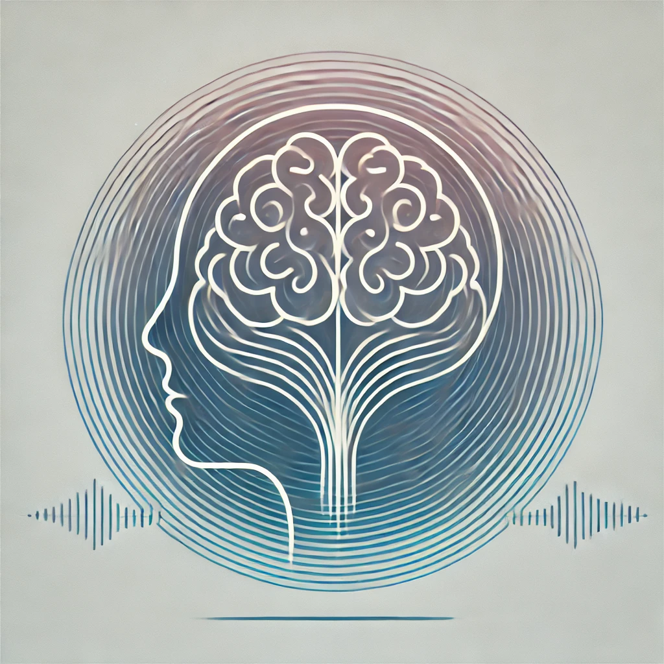
How can we understand the psychological effects of music?
Self-report:
Questionnaires,
Interviews,
Experience Sampling
Behavioural tests
Observations of behaviours
Physiological measures
Cardiac, gaze, brain, etc.
ChatGPT 4o
Notes:
What is advantage of physio measurements?
Disadvantage?

Slide 21
Why might we want to better understand connections between physiology and musical experience?
To create more immersive music or musical experiences
To develop new forms of musical expression, or opportunities for performer-audience interactions
Notes:
Can we measure it with a mic?
What kind of sensors can we use?

Slide 22


Why might we want to better understand connections between physiology and musical experience?
To advocate for social change, justice, or solidarity
Notes:
Can we measure it with a mic?
What kind of sensors can we use?

Slide 23
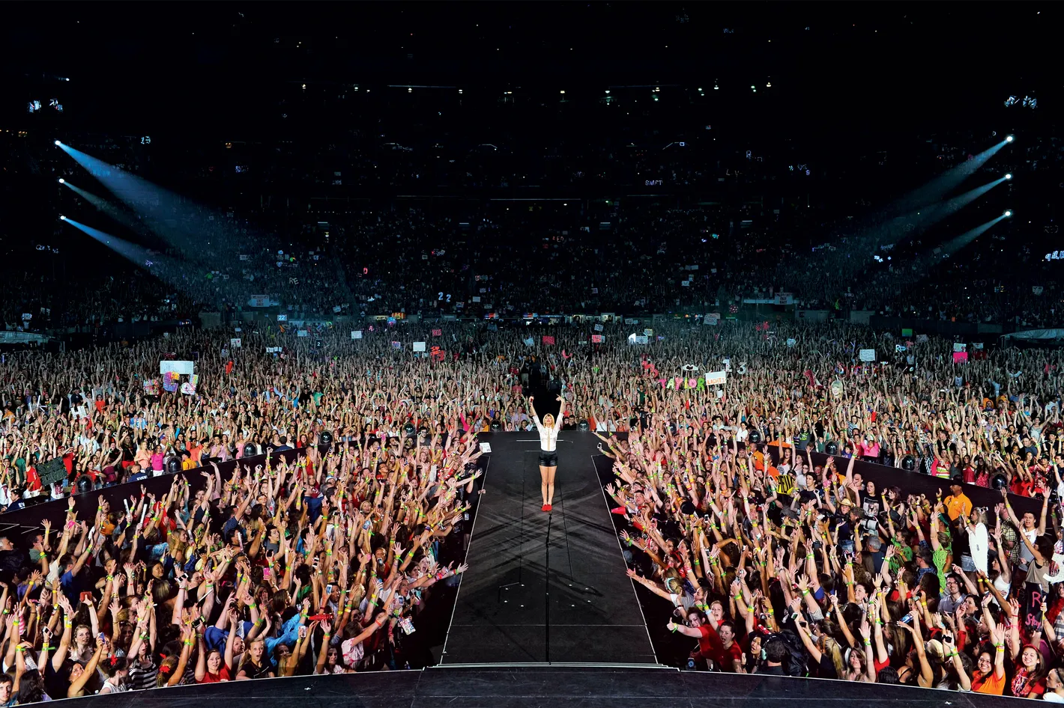

Why might we want to better understand connections between physiology and musical experience?
To sell things to people
Music is multi-billion dollar industry.
Canada’s music industry currently outpacing US
Notes:
Can we measure it with a mic?
What kind of sensors can we use?

Slide 24
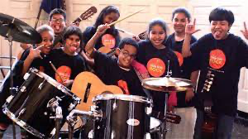
Why might we want to better understand connections between physiology and musical experience?
To foster social connection
To regulate emotion, attention, arousal
Notes:
Can we measure it with a mic?
What kind of sensors can we use?

Slide 25
More generally..
Studies on music have the potential to change or influence existing theories on:
Emotions
Memory
Creativity
Time perception
Auditory perception
Motor control
Nonverbal communication
Social bonding
Slide credit: Kelly Jakubowski
Notes:
Can we measure it with a mic?
What kind of sensors can we use?

Slide 26
Plan for the rest of the day
Hands-on demo on how to analyze music signals
Gentle introduction to Python
LUNCH
Lecture & Hands-on demo of Cardiac Monitoring
Lecture & Hands-on demo of Eye Tracking
Wrap Up & Final Discussion
Notes:
Can we measure it with a mic?
What kind of sensors can we use?

Slide 27

Thank you! Contact: Lauren Fink, PhD Asst. Professor finkl1@mcmaster.ca FINK L 1
Notes:
TODO photo of lab

